Slide 1


PySpark from Scratch - Part I
Carlos Contreras, Big Data & Analytics architect

Slide 2

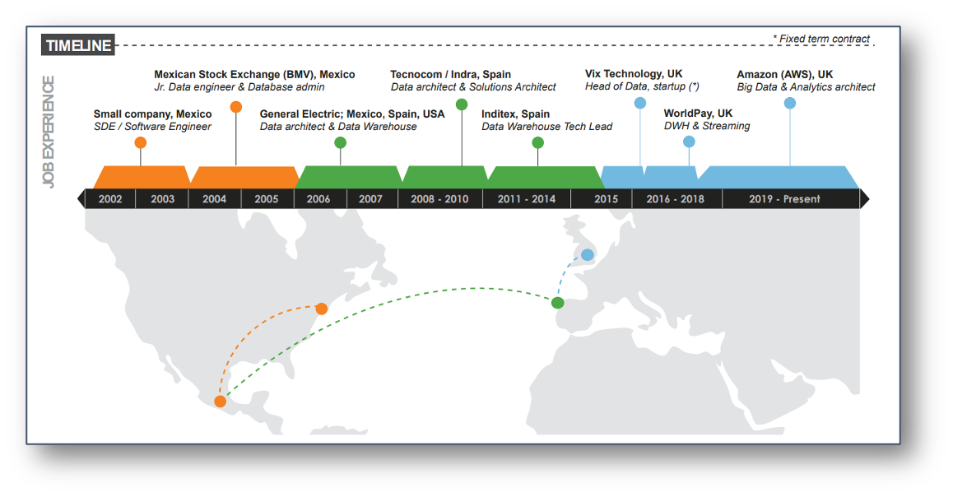
linkedin.com/in/carloscontreras/
Disclaimer: I’m not representing AWS, but myself only. This educational training is not an AWS official course.

Slide 3
Format of this Training
Ready-made / End-to-end Use Cases to build
Medium to High Knowledge required
Oriented to build, with solid skills
Real World Examples-based to explain
Basic knowledge required about Python
Oriented to learn knowledge base

Slide 4
Syllabus
How Apache Spark works
Why PySpark and not something else; e.g. Pandas
PySpark basics — e.g. Resilient Distributed Datasets (RDD)
How to process data with PySpark
Optimizations in Apache Spark
Dealing with complex clusters; i.e. multi-node environments

Slide 5

Next…

